Slide 1
Capstone Project Final Assignment
The Battle of Neighborhoods

Slide 2
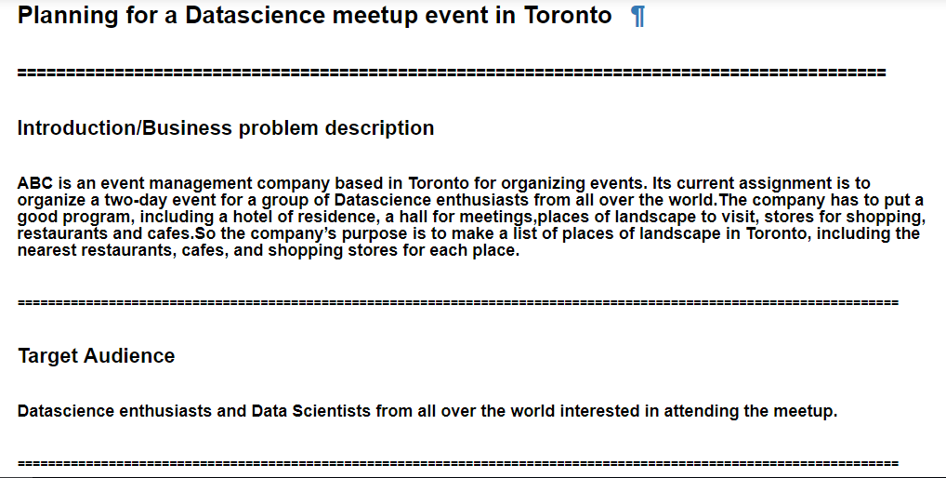
Introduction to problem statement and target audience

Slide 3
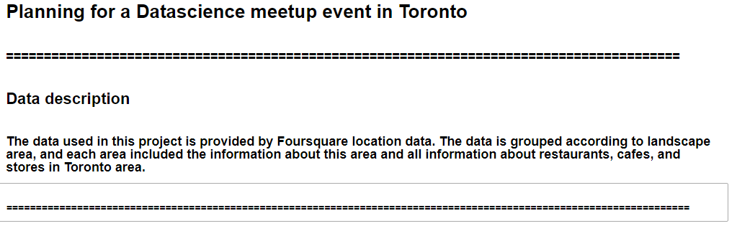
Data description

Slide 4
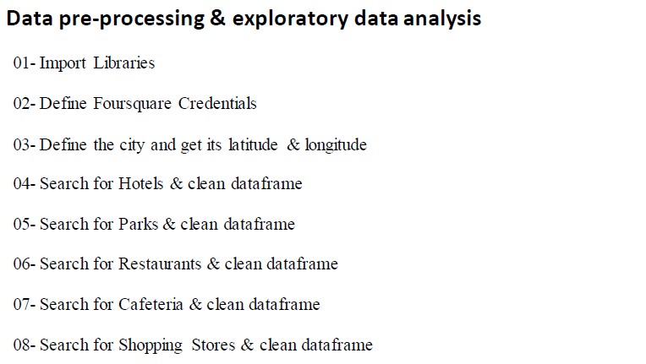
Data pre-processing and EDA

Slide 5
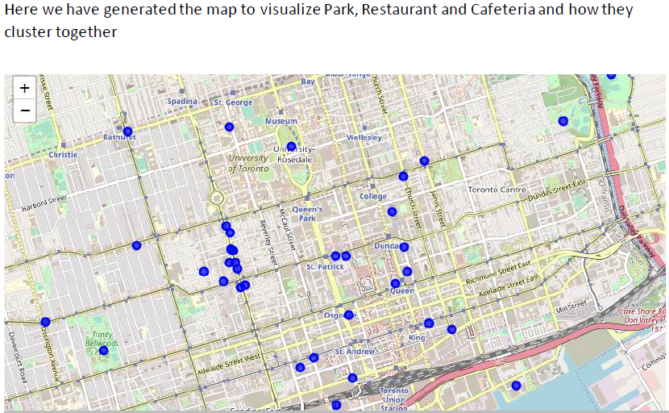
Results and Visualization

